Slide 1



FAKE SOCIAL MEDIA PROFILE DETECTION AND REPORTING
PRESENTED BY TEAM TRUTH TRACKERS

Slide 2
TEAM MEMBERS DETAILS
Team Leader Name: M.Sanjana
Branch :B.Tech Stream : AIML Year : III
Team Member 1 Name: G.Soujanya
Branch :B.Tech Stream : AIML Year : III
Team Member 2 Name: B.Jayanth
Branch :B.Tech Stream : AIML Year : III
Team Member 3 Name: T.Harshitha
Branch :B.Tech Stream : AIML Year : III
Team Member 4 Name: M.Pavan teja
Branch :B.Tech Stream : AIML Year : III
Team Member 5 Name: B.Karthik reddy
Branch :B.Tech Stream : AIML Year : III

Slide 3

Idea/Approach Details
•Unmasking the Shadows: Dive into the thrilling world of Fake Instagram Profile Detection.
•Our pioneering solution is on the frontline of the battle against digital deception.
•Detecting fake Instagram profiles is an essential challenge in the realm of online security and social media integrity.
• We focus on developing robust algorithms and machine learning models to distinguish between genuine and deceptive Instagram profiles. Leveraging a combination of feature engineering, deep learning techniques, and data analytics.
•We aim to identify patterns and anomalies in user behaviors, profile attributes, and content sharing activities. By examining factors such as profile picture , followers, posts, and textual analysis of profile descriptions and comments.
•Weseek to enhance the accuracy of fake profile detection, contributing to a safer and more trustworthy online social networking environment.

Slide 4

OBJECTIVES
•The primary purpose of the fake accounts is to spread the spam content.
•The main objective of our project is to detect these fake accounts.
•The project aims to enhance the overall security and trustworthiness of the Instagram platform by effectively identifying fraudulent users, ultimately creating a safer and more reliable environment for users to interact and share content.

Slide 5

ALGORITHMS INVOLVED IN OUR MODEL
SUPPORT VECTOR MACHINES(SVM):
•Support Vector Machines (SVMs) are applied in fake profile detection by utilizing their ability to classify profiles into genuine and fake categories based on extracted features.
•These features often include attributes such as profile picture quality, posting patterns, engagement metrics, and textual analysis of profile descriptions and comments.
• A labeled dataset comprising known genuine and fake profiles is used for SVM training, with the objective of finding the optimal hyperplane that maximizes the separation between these two classes.
•Once trained, the SVM can effectively classify new profiles, assessing their position relative to the hyperplane, thereby aiding in the automated detection of fraudulent or deceptive profiles on social media platforms like Instagram.

Slide 6

GRADIENT BOOSTING:
•Gradient Boosting, particularly algorithms like Gradient Boosting Machines (GBM) or XGBoost, is employed in fake profile detection by constructing a powerful ensemble model that iteratively combines the predictions of multiple weak learners, typically decision trees, to enhance classification accuracy.
•In this context, individual profiles serve as data points, and features like profile attributes, posting behaviors, and engagement patterns are used as input. Initially, the algorithm creates a base learner, often a simple decision tree, which makes initial predictions.
•The subsequent learners focus on correcting the errors of the previous ones, effectively learning to distinguish between genuine and fake profiles by emphasizing challenging or misclassified cases.
• This iterative process continues until the model converges to an optimal solution.
• The resulting ensemble model provides robust detection capabilities, capable of identifying fake profiles with high accuracy by leveraging the collective strength of multiple weak learners.

Slide 7

Random Forest
•The Random Forest algorithm is utilized in fake profile detection by constructing an ensemble of decision trees to enhance the accuracy and robustness of classification.
•In this context, individual user profiles are treated as data points, with various features extracted from these profiles, including attributes like profile picture quality, posting patterns, engagement metrics, and textual analysis of profile descriptions and comments.
•Random Forest builds a multitude of decision trees, each trained on a random subset of the data and features.
•During classification, each tree makes its prediction, and the final classification is determined by a majority vote or averaging of the individual tree outputs.
•This ensemble approach reduces overfitting, increases accuracy, and provides a more reliable method for identifying fake profiles, making Random Forest a valuable tool in automated fake profile detection systems.

Slide 8
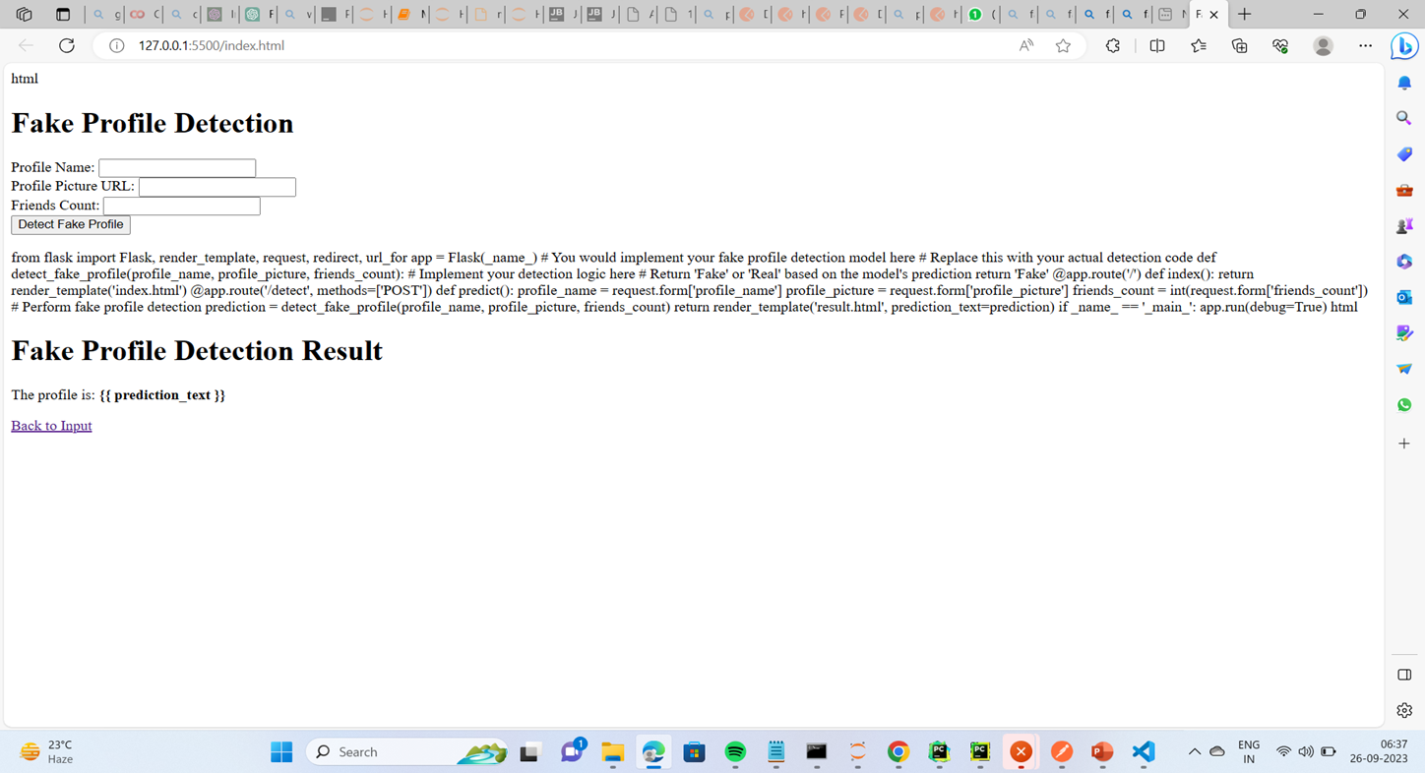
SAMPLE OUTPUT

Slide 9
Future work
1.Deep Learning and Neural Networks:
Explore the application of deep learning techniques and neural networks, such as convolutional neural networks (CNNs) for image analysis and recurrent neural networks (RNNs) for text analysis. These advanced approaches can help improve the accuracy of fake profile detection.
2.User Behavior Analysis:
Shift the focus from individual profile analysis to analyzing user behavior across a platform. Identify network-level anomalies and behavioral patterns indicative of coordinated fake profile activity.
3.Cross-Platform Analysis:
Extend the project to analyze fake profile presence and behavior across multiple online platforms. Fake profiles may use different tactics on different platforms, and cross-platform analysis can provide a more comprehensive view.
4.Collaboration with Social Media Platforms:
Collaborate with social media and online platform companies to share insights, data, and best practices for fake profile detection. This partnership can help improve detection and response efforts.
5.Benchmarking and Evaluation:
Continuously evaluate and benchmark your fake profile detection models against new and evolving datasets. Participate in fake profile detection challenges and competitions to assess your model's performance.

Slide 10

REFERENCE
Kaggle.com
Netguru.com
Openai.com
Knowledgehunt.com
Google.com
Blog.coupler.io
Github.com

Slide 11

THANK YOU VERY MUCH!
TEAM TRUTH TRACKERS

